Slide 1

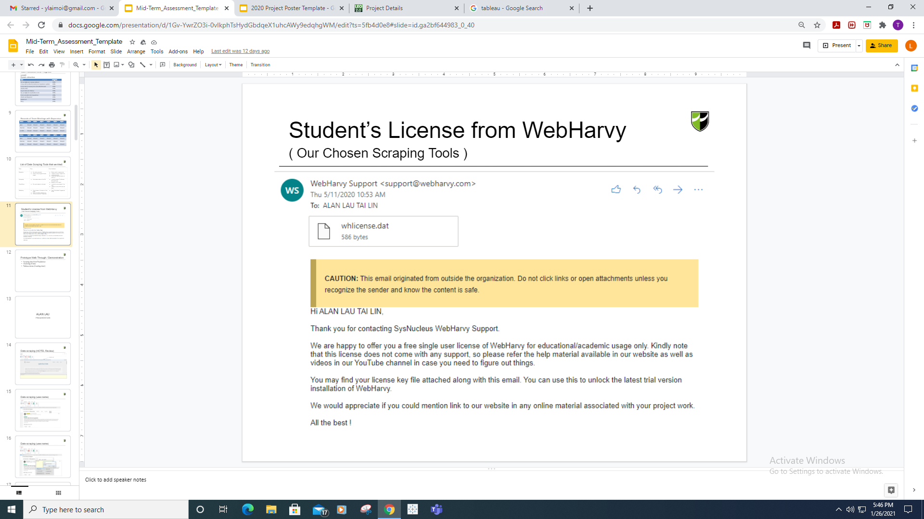
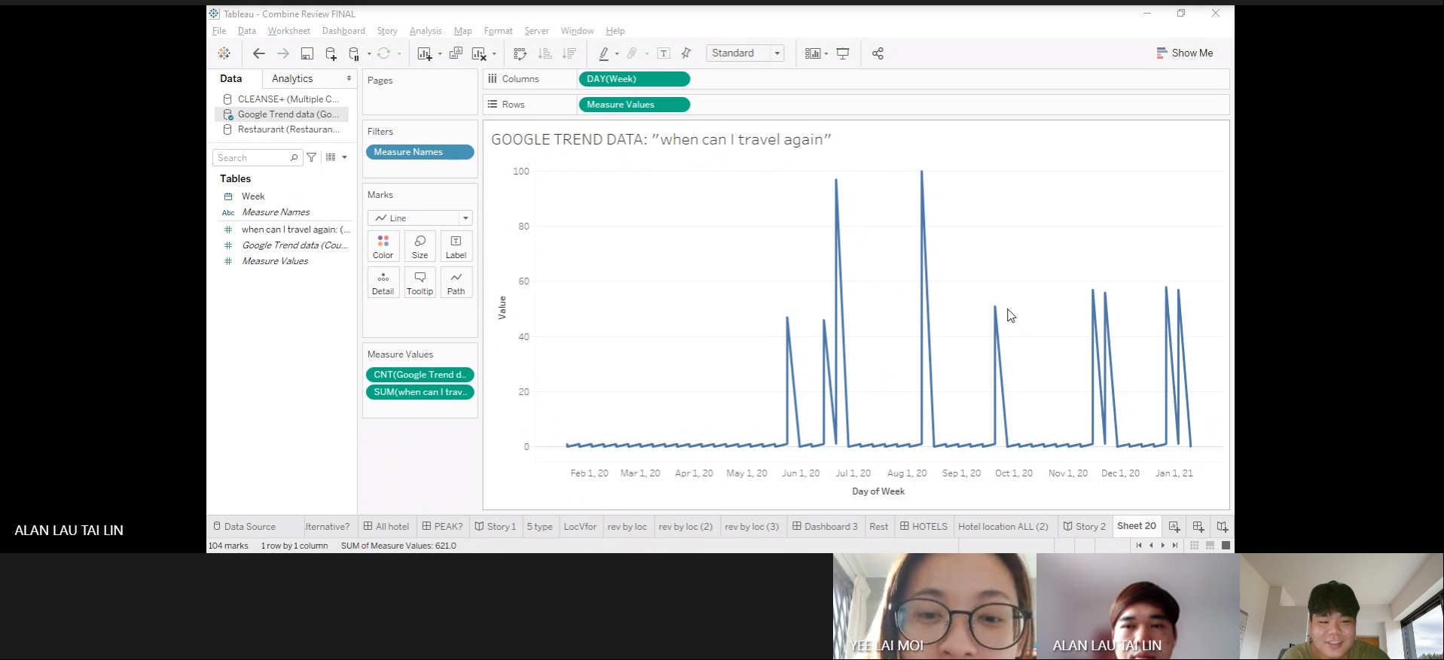
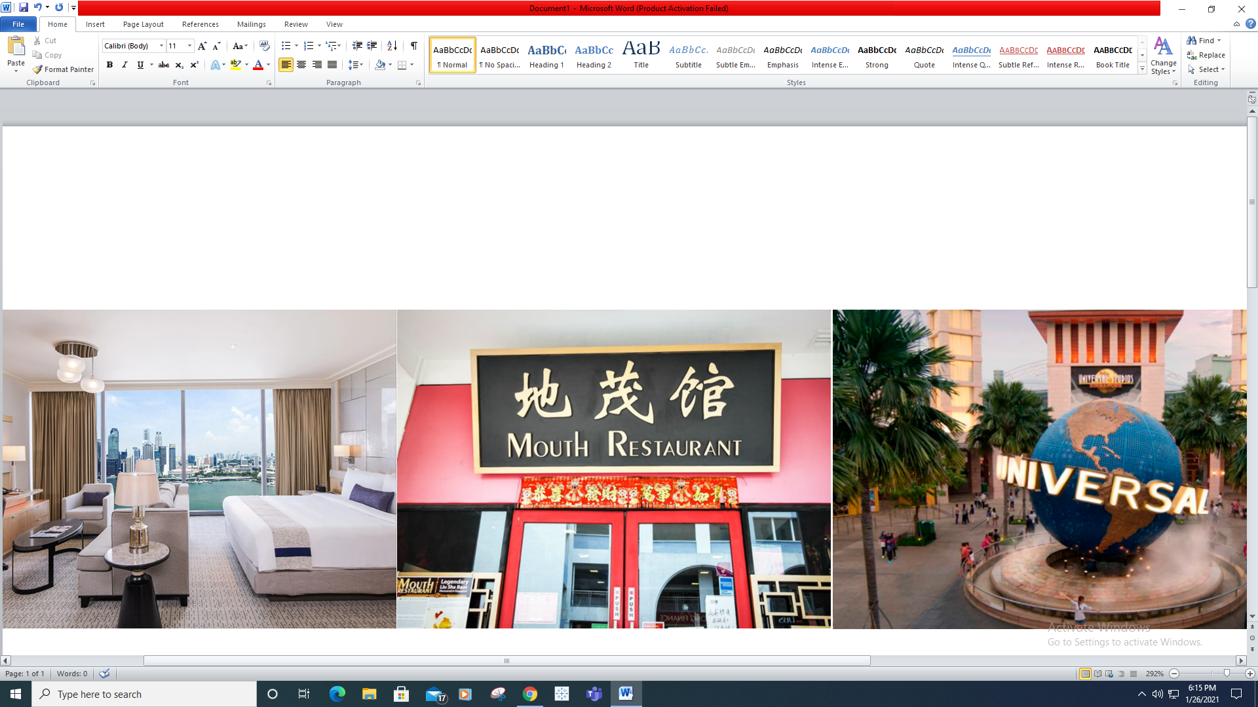
TripAdvisor Data Scraping and Analytics Project
Project Overview
Problem:
This project consists of 2 parts where the team will do Data Scraping and Data Analytics.
The team will first scrap data using free scraping tool on Singapore Hotel reviews from TripAdvisor website. The team will carry out data analytics from the data scraped from TripAdvisor to derive hotel guests profiles and build a model to find out which are the key factors (based on the rating data) that different hotel guest profiles are concerned about in their choice of hotels/accommodation.
Requirements: Demonstrate data visualization knowledge and skills and exploration of the analytics tool. Scraped Data Guide on the data scrapping tool, Visualisation Dashboard, Predictive Model Guide on creating this predictive model and interpretation of the model Final FYP Report.
Solution: Adopt commonly used data mining methodology and include any data exploration and data cleansing steps to produce meaningful insights from the data before the analytics using Tableau or any visualization tool.
Technologies: BI knowledge & Skills (Tools: Excel, Tableau)
We got a student’s license from WebHarvy
Team Members
Alan Lau, Liew Chia Yee, Yee Lai Moi
Dr Tan Lee Kiat (supervisor)
Each of us are doing a different domain: Hotel, Restaurant, Attraction
Notes:
NOTES
Refer to write ups in ‘Past Projects for Reference’ Booklet for Project overview write ups - http://yoda.soi.rp.edu.sg/wiki/index.php/FYP_Wiki
ENGLISH - British E.g. organisation VS organization
Font: RP approved font - Arial family only.
Header: Arial Bold
Copy text: Arial regular or Arial Bold. Use Emphasis of our SOI orange in moderation.
Picture frame – Give a 4.5 or 6pt orange outline.

